Slide 1
CARE & Labour Rights
Workers in the Informal Economy
Laura Alfers, Wiego social protection programme – 28 July 2020

Slide 2
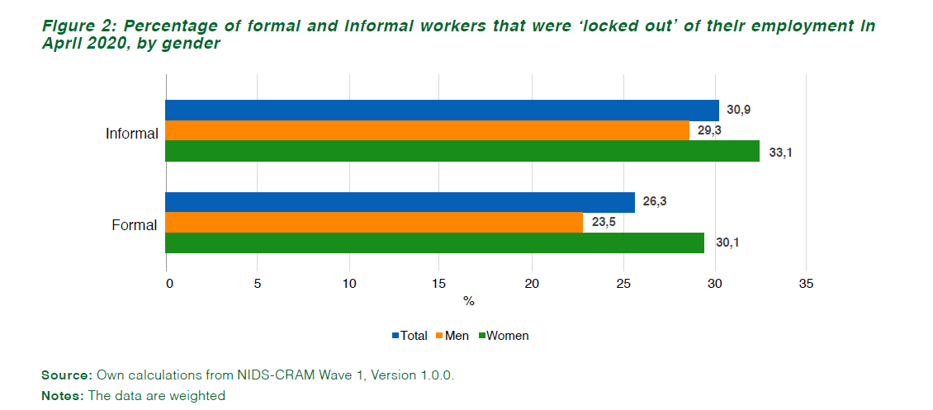
NIDS-CRAMS Survey Wave 1 (south Africa)
Rogan, M & Skinner, C. 2020. The Covid-19 Crisis and the South African Informal Economy. Policy Brief No. 10. NIDS-CRAMS Wave 1.
Notes:
So is this hypothesis being borne out in the data – South Africa has just released first wave of its CRAM data (sample of 7000 plus).
Indeed women have borne the brunt of the job losses – making up 2/3 of the job losses, but less than 50% of the employed population.
This data is not about those who have lost jobs (limitation of the dataset) – its about those who still think of themselves as employed, but who were unable to work during the full lockdown in April
This figure shows that informal workers were hit harder – with about 31 percent reporting an inability to work in April vs 26 percent of formal workers. BUT across both formal and informal work, women were hit the hardest with 33 percent of women in informal employment, and 30 percent of women in formal employment reporting this.

Slide 3
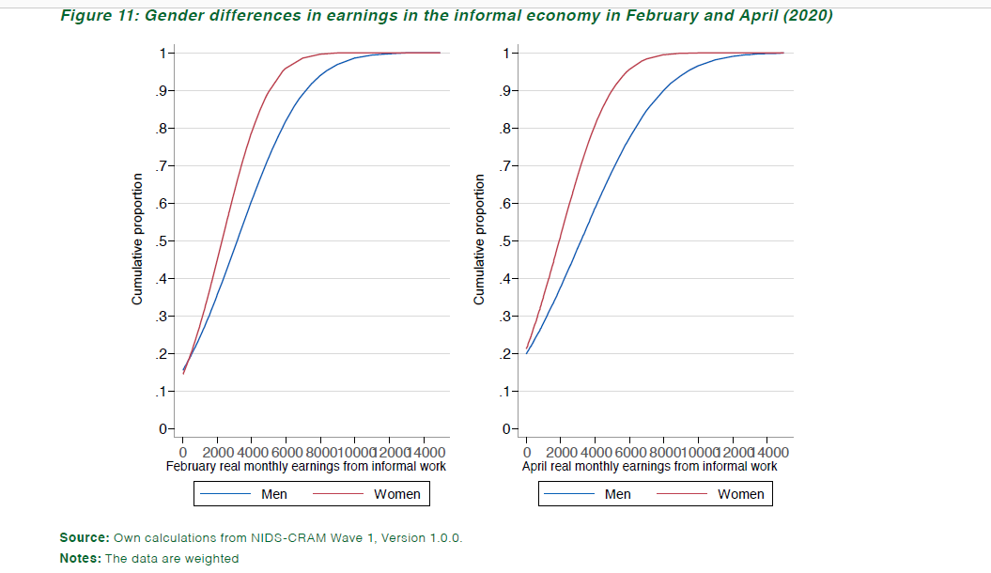
Rogan, M & Skinner, C. 2020. The Covid-19 Crisis and the South African Informal Economy. Policy Brief No. 10. NIDS-CRAMS Wave 1.
Notes:
- Important part of this slide is the distance between the blue and red lines of the income distribution between February (pre lockdown) and April (during lockdown).
- The red represents women’s incomes, the blue represents men’s incomes and you can see that the distance widens in April – so that show that the gendered differential in incomes during the lockdown period.

Slide 4
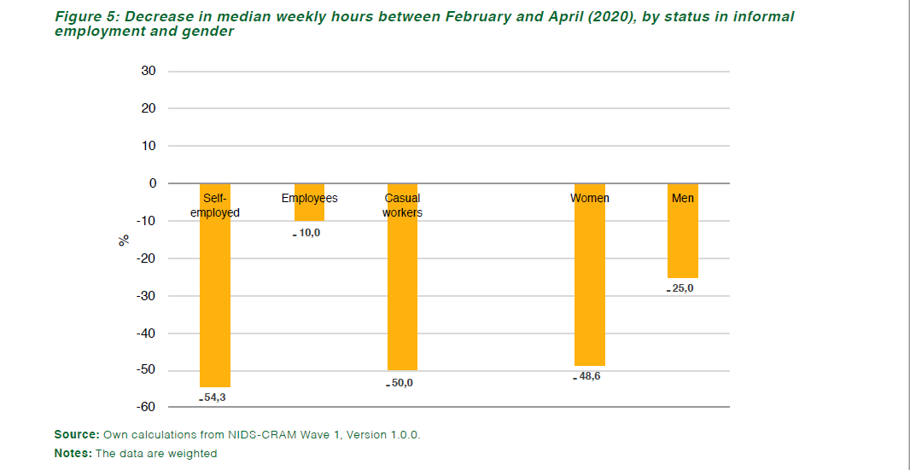
Rogan, M & Skinner, C. 2020. The Covid-19 Crisis and the South African Informal Economy. Policy Brief No. 10. NIDS-CRAMS Wave 1.

Slide 5
CARE-WORK Linkages in the IE
65% of women in informal employment reported spending more time in April taking care of children (compared with 58% of men).
  Less than the overall sample average for women which was 73% (with 80% reporting increase of 4+ hrs per day)
  Child care strategies of self-employed? (bringing children to work)
  Self-employed hit hardest in terms of loss of work hours (particularly women) in April
70% of women informal employees (and only 50% of men) reported an increase in care responsibilities:
  This was also the single largest group who reported zero working hours during the month of April.
Rogan, M & Skinner, C. 2020. The Covid-19 Crisis and the South African Informal Economy. Policy Brief No. 10. NIDS-CRAMS Wave 1; Casale, D& Posel, D. 2020. Gender and the early effects of C-19 on paid and unpaid economies in SA. Policy Brief No. 4. NiDS-CRAMS Wave 1.

Slide 6
Economic Recovery for women informal workers
Representation of informal workers in policy dialogue spaces
- governments should partner with organizations of informal workers in developing recovery plans.
Extension of social protection over longer term
  Including support for care responsibilities
Greater priority for child care provision in public spending
  Guidelines & support for safe re-opening of ECD facilities & creches (formal & informal)
Inclusion of informal workers in sectoral economic recovery plans

Slide 7
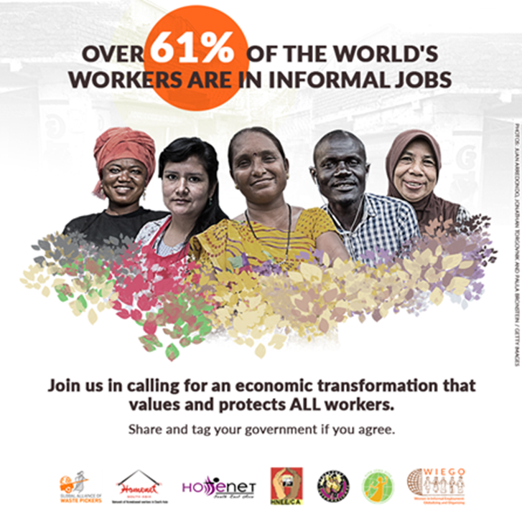
2 Billion Strong: Recovery Starts with Us
#RecoveryStartsWithUs
#LaRecuperaciónComienzaConNosotrxs
#EssentialNotExploited
#EsencialesNoExplotadxs
Global Solidarity Platform:
https://www.wiego.org/COVID19-Platform
(ENG, ESP, POR, FR, KiSwahiil, Hindi, Russ)
Support MBO campaigns:
https://www.wiego.org/support-informal-workers-campaigns

Slide 8
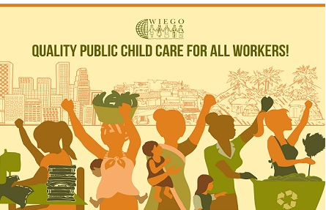
Child Care campaign
Campaign Materials
https://www.wiego.org/wiegos-child-care-campaign
(ENG, ESP, FR, POR, Thai, KiSwahili, isiZulu, Hindi)

Slide 9
Women in informal employment: globalizing and organizing (WIEGO) is a global network focused on securing livelihoods for the working poor, especially women, in the informal economy. we believe all workers should have equal economic opportunities and rights. WIEGO creates change by building capacity among informal worker organizations, expanding the knowledge base about the informal economy and influencing local, national and international policies. visit www.wiego.org
Thank You

